Slide 1
World Domination with wordpress
Collaboration for Business
How your WordPress website can be the perfect platform for business collaboration.

Slide 2
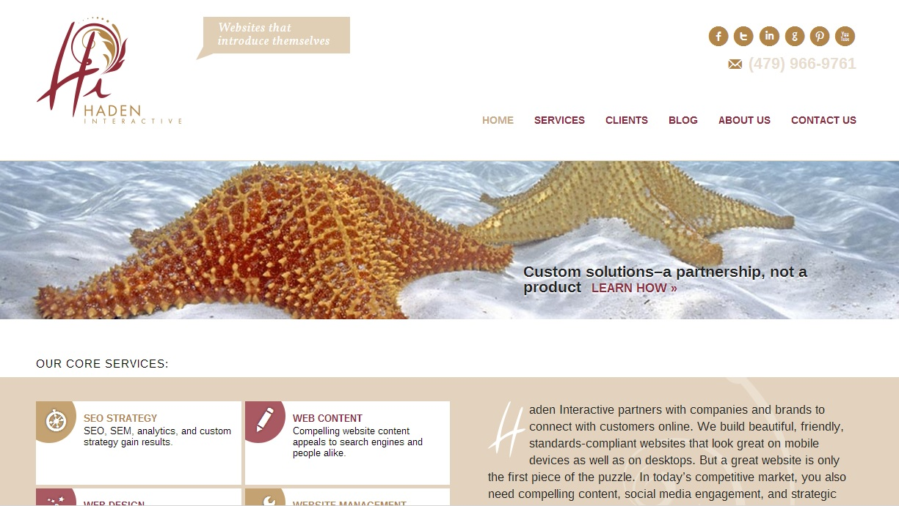
About Us
Haden Interactive builds, optimizes, and manages WordPress websites for large and small organizations on four continents.
www.HADENINTERACTIVE.com
Haden Interactive
Address: 1337 E. Ash, Fayetteville, AR
Phone: 479.966.9761
Email: info@hadeninteractive.com
02

Slide 3
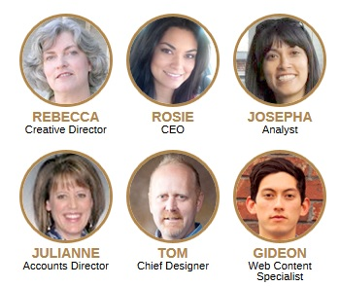
Our Team
Several of us are here at WordCamp. We’re happy to answer questions and we want to meet you.
John Doe
06

Slide 4
Service List
Web design
Web content
WordPress websites
SEO analysis and strategy
Website optimization
Blogging
Link building
Social media management
Email marketing
PPC
Search Engine
Optimization
SEO/SEM includes a lot of different activities, including on-page optimization of content and code, strategy based on analytics, and off-page actions like link-building, guest posting, and integrating social media and advertising.
04

Slide 5
Who needs collaboration tools?
Businesses/Organizations
Agencies/Freelance WordPress talent
Bloggers with big plans
04

Slide 6
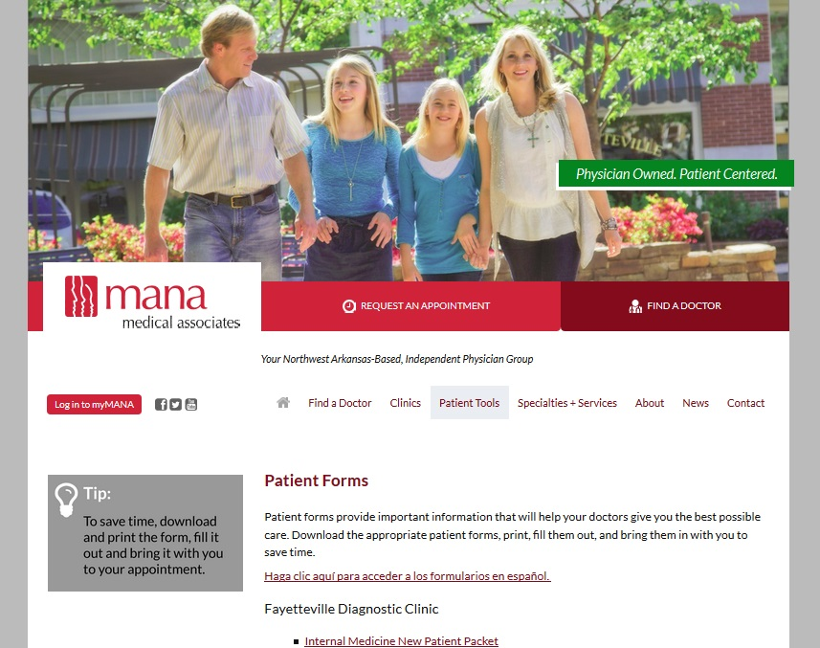
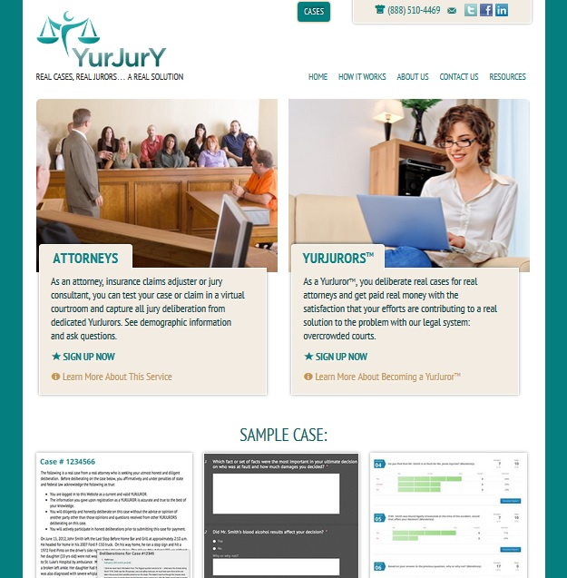
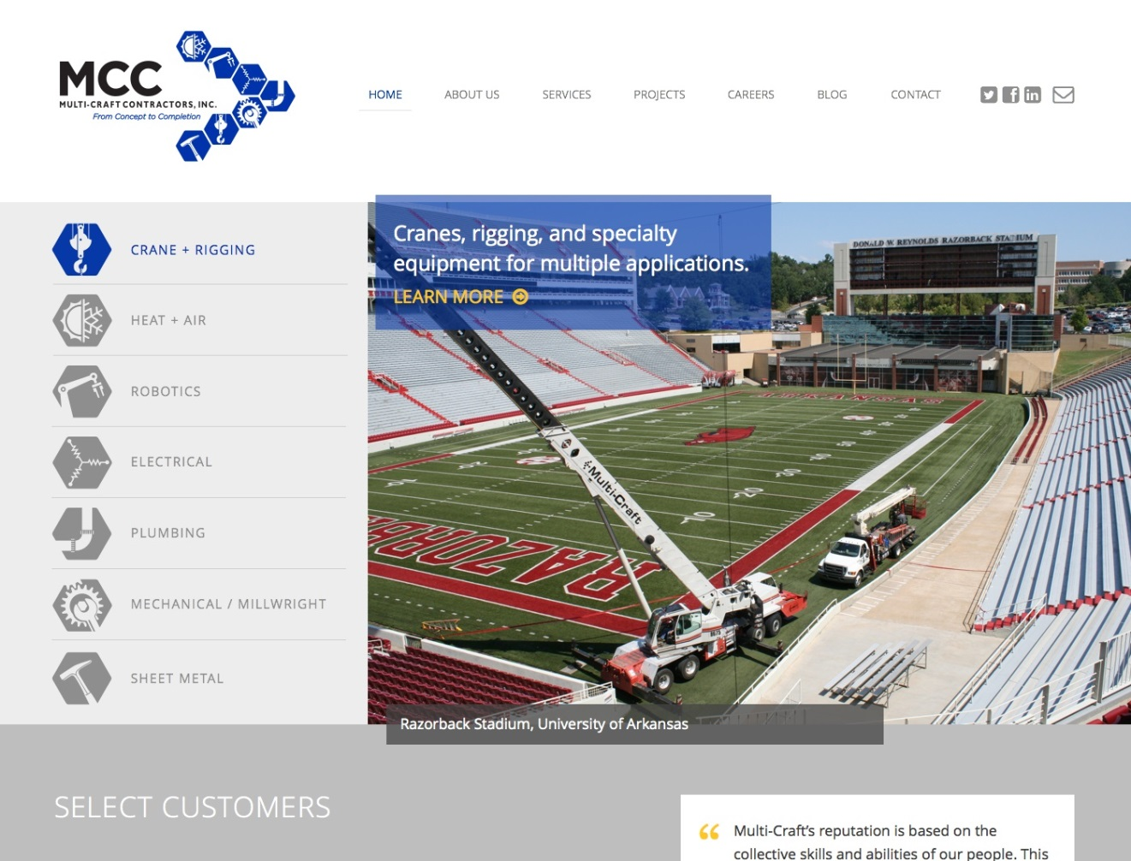
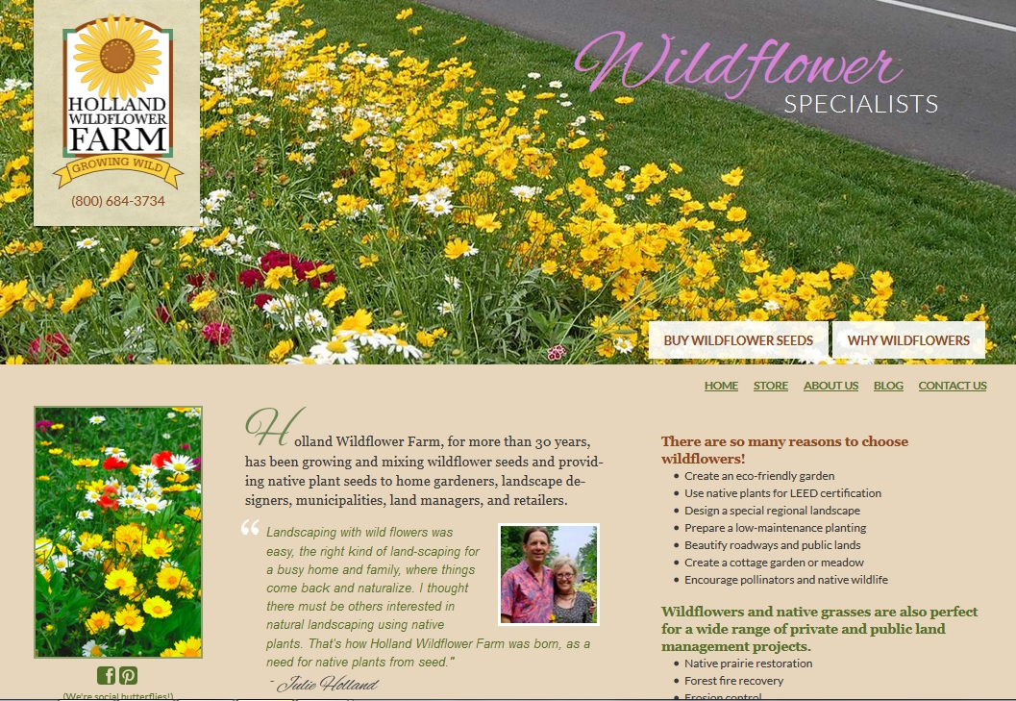
Businesses Using WordPress
Collaboration Challenges:
Multiple locations
On-site and remote workers
Helpers typing in products
Need to send or receive files
Different time zones
Flexible schedules
Distinct departments
15

Slide 7
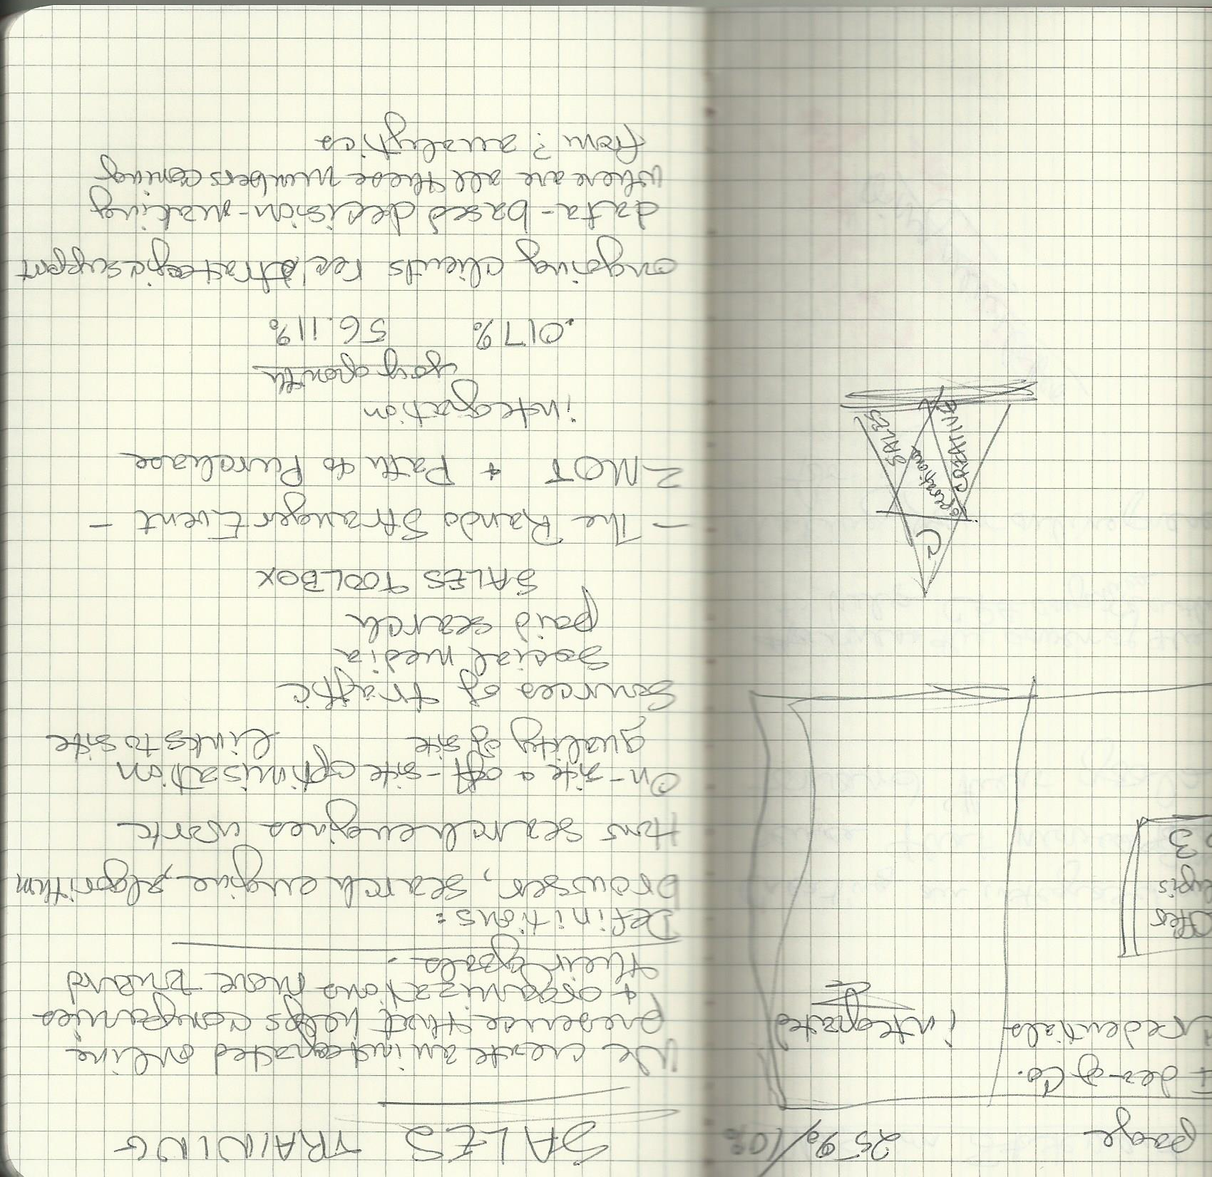
Agencies Using WordPress
Your clients don’t really think this is the best way to communicate.
Provide better options.
15

Slide 8
Bloggers with Big Ideas
1,000,000 +unique visits/month
2,000,000+ pageviews/month
$100,000 in ad revenue/year
These results take teamwork!
15

Slide 9
WordPress makes collaboration easy, even with remote workers.
Across the hall
or across the world.

Slide 10
What’s built into WordPress
It’s in the cloud for always/everywhere access.
People without special skills can use it easily.
User management tools give you control over access.
You’ll get warnings if you’re working in the same place at the same time. (Sometimes.)
11

Slide 11
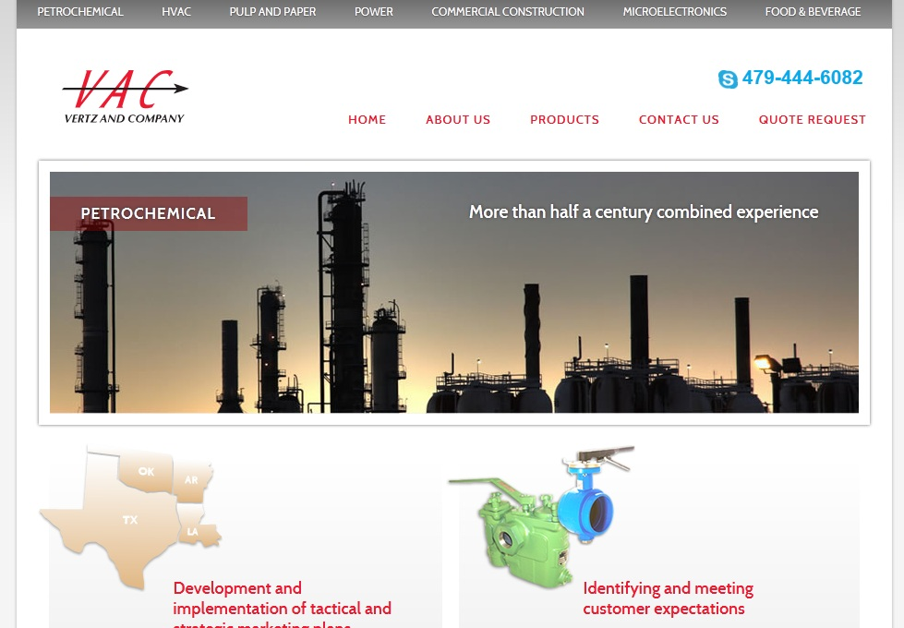
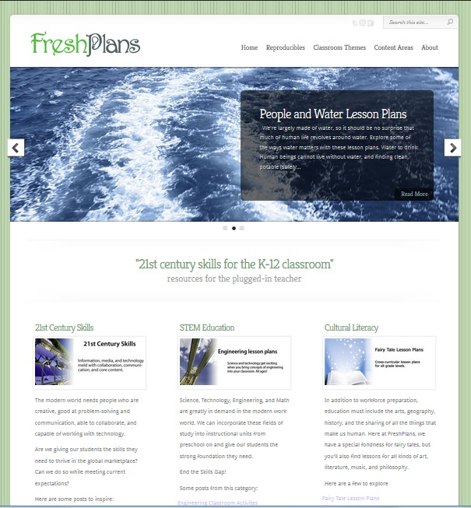
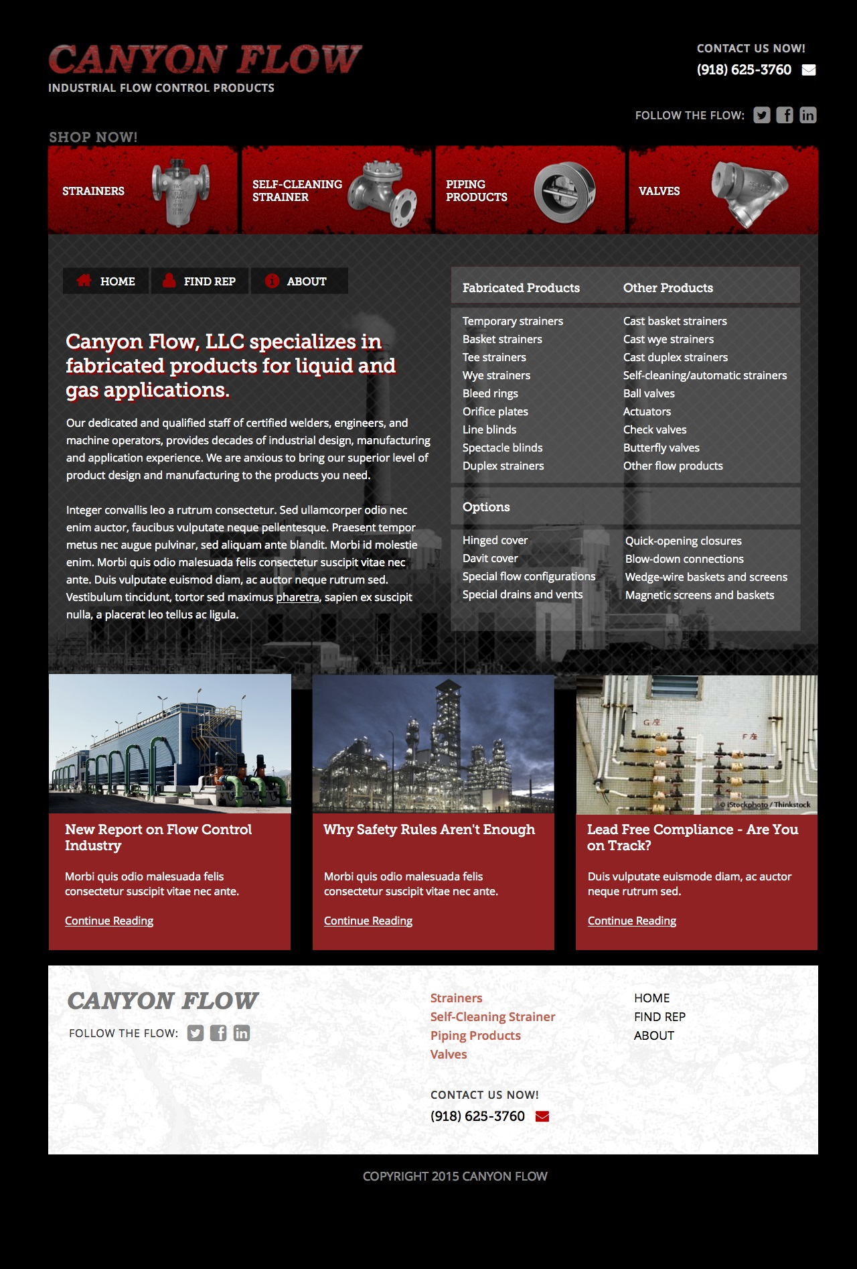
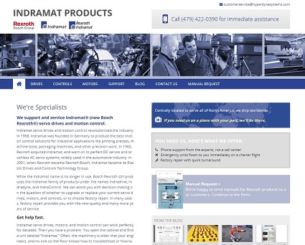
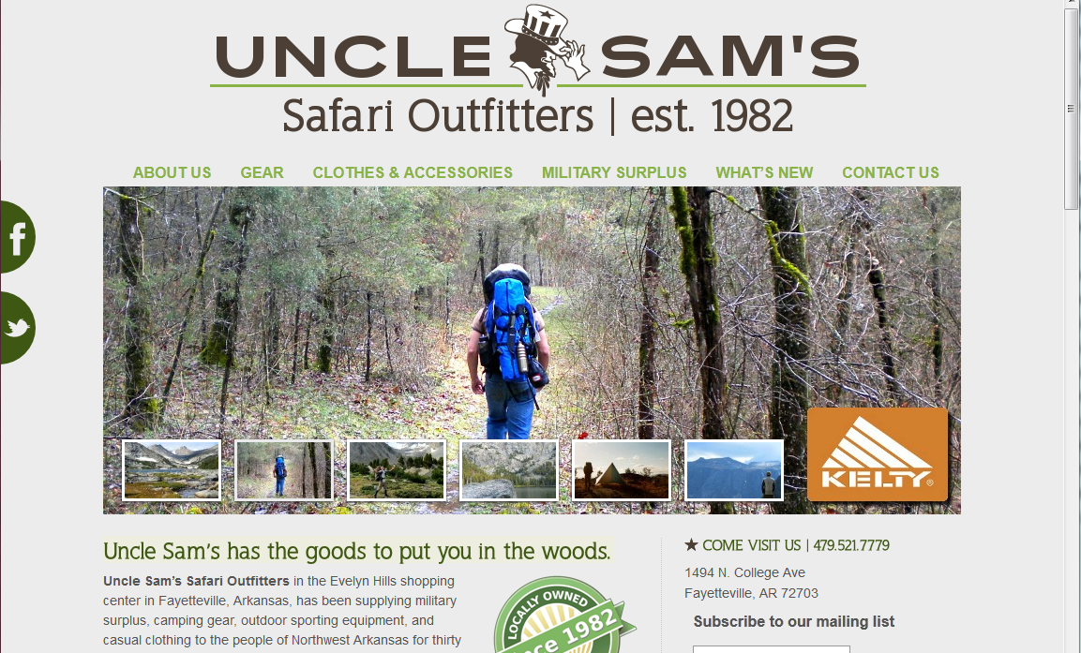
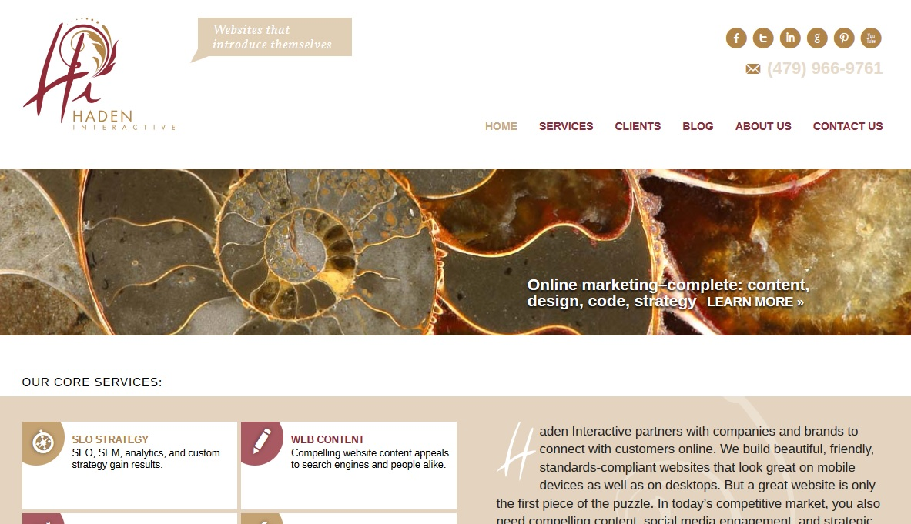
The front of your website

Slide 12
The back of your website – AKA the admin area

Slide 13
How Safe Is It to Run Your Business from Your Dashboard?
User roles control access.
Many tools add extra user roles.

Slide 14
User Management

Slide 15
User Management

Slide 16
User Management

Slide 17
What you can add to WordPress
There were
38,118
plugins at WordPress.org on June 1, 2015
Use a theme built for collaboration.
Use BuddyPress.
Use plugins built to improve collaboration.

Slide 18
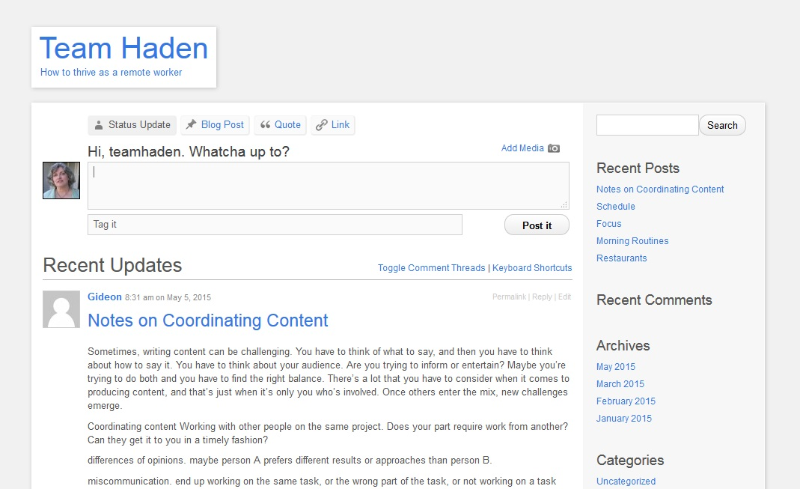
Themes for Collaboration: P2
09

Slide 19
Themes for Collaboration: Ones I Haven’t Tried
Hub
EmployeePress
gForums
KnowPress
Collaboration by Template Toaster
09

Slide 20
BuddyPress
Twitter-like activity stream
Private messaging for individuals or groups
Site tracking
Notifications
User groups
09

Slide 21
Edit Flow: Story Budget

Slide 22
Edit Flow: Calendar

Slide 23
Edit Flow: Version Control

Slide 24
Edit Flow: Communication

Slide 25
Edit Flow: Comments

Slide 26
Collaborating with WordPress: Project Management
WPProject Management

Slide 27
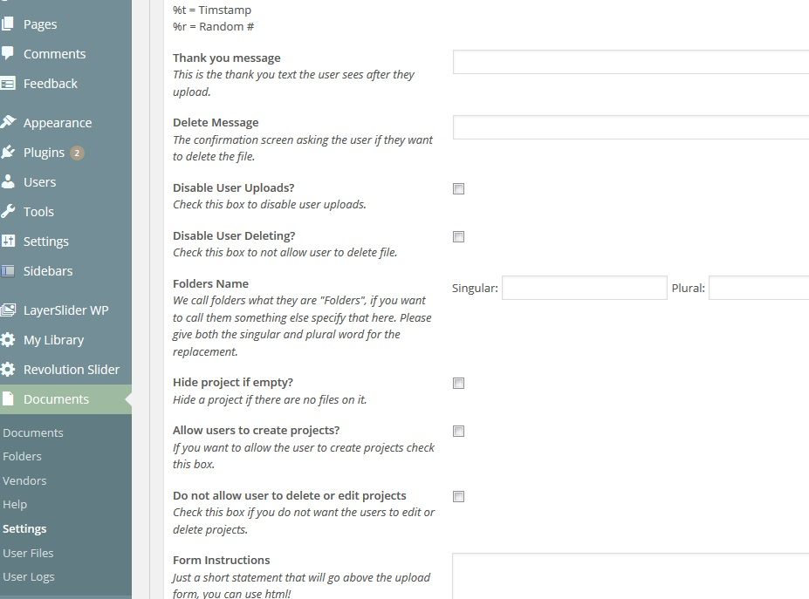
Collaborating with WordPress: Project Management
SP Project &
Document Manager

Slide 28
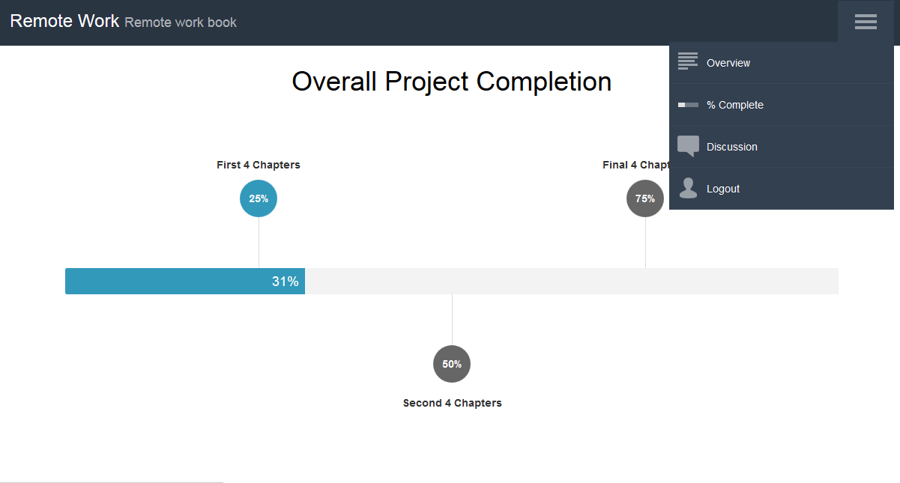
Collaborating with WordPress: Project Management
Project Panorama

Slide 29
Plugins for Collaboration: Badgeos
Award badges to team members when they complete tasks or are nominated.
Build badges at Credly.
Keep people motivated, gamify projects, encourage competition, or let people give each other props.
Keep morale high with limited contact.
Show to users or display on a page.

Slide 30
Questions?
@RebeccaHaden
Rebecca@HadenInteractive.com

Slide 31
Thank you for your attention !
www.hadeninteractive.com

