Slide 1


Content Clusters
An Advanced SEO Technique

Slide 2



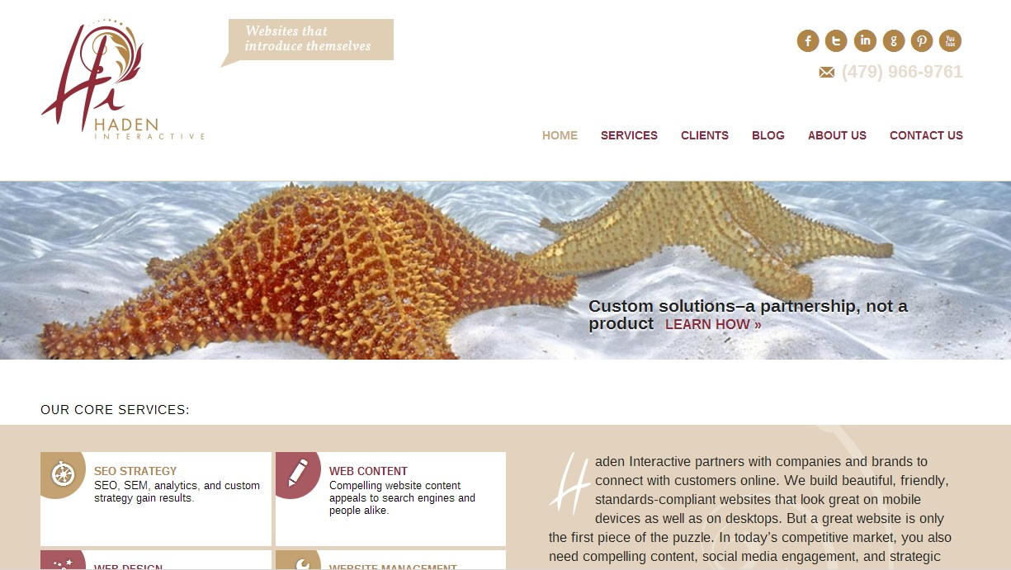
About Us
Haden Interactive builds, optimizes, and manages WordPress websites for large and small organizations on four continents.
www.HADENINTERACTIVE.com
Haden Interactive
Address: 1337 E. Ash, Fayetteville, AR
Phone: 479.966.9761
Email: info@hadeninteractive.com
02

Slide 3


Our Team
Meet us here at WordCamp or at www.hadeninteractive.com
Rebecca Rosie Gideon Brittany
06
Notes:
Here’s our team – we’d love to meet you and we’re happy to answer questions.

Slide 4
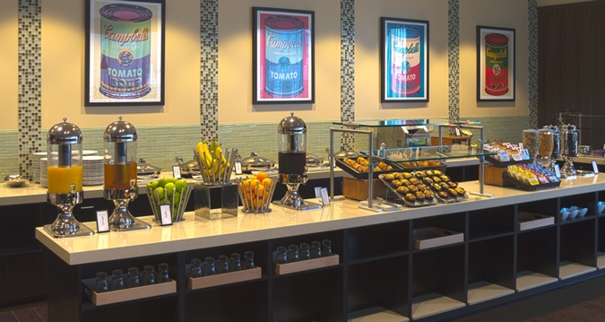
A metaphor

Slide 5
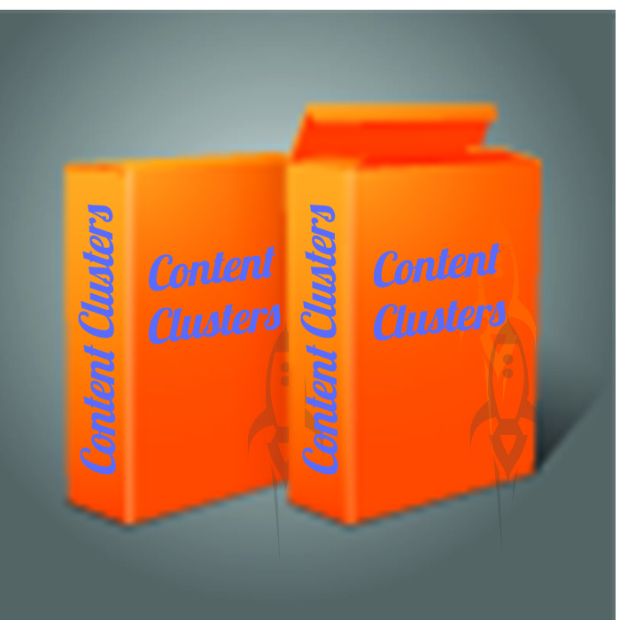

Slide 6
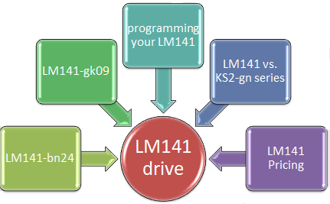
Content Clusters
Next:
Step by Step Instructions and Specific Tools

Slide 7
Before you start Content Clusters
Build a good quality website. www.hadeninteractive.com/technical-seo-vs-content-seo/
Determine the goals for your content. www.hadeninteractive.com/what-are-your-website-goals/
Create good content for basic pages. www.hadeninteractive.com/is-it-ok-to-have-bad-content/
Create appropriate meta data and titles. www.hadeninteractive.com/metadata-for-seo/
Develop a content marketing strategy. www.hadeninteractive.com/content-marketing-step-by-step/
Identify customers and path to purchase. www.hadeninteractive.com/perfect-buyer-persona/

Slide 8
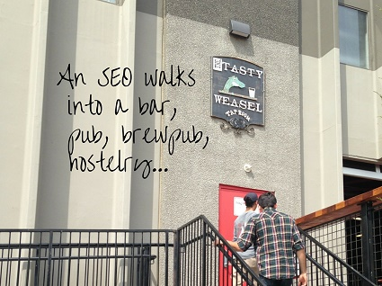
Step 1: Choose the main keyword
Choose the right hub keyword.

Slide 9
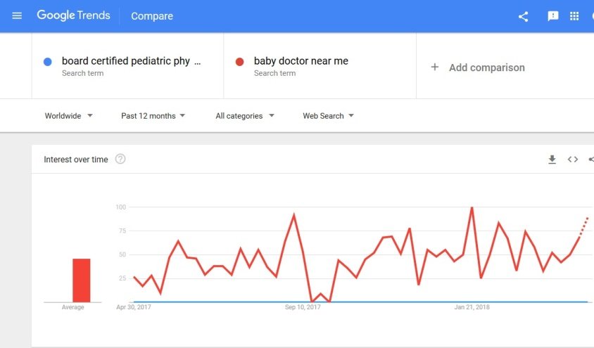
Keywords people actually use
www.trends.google.com/trends/

Slide 10
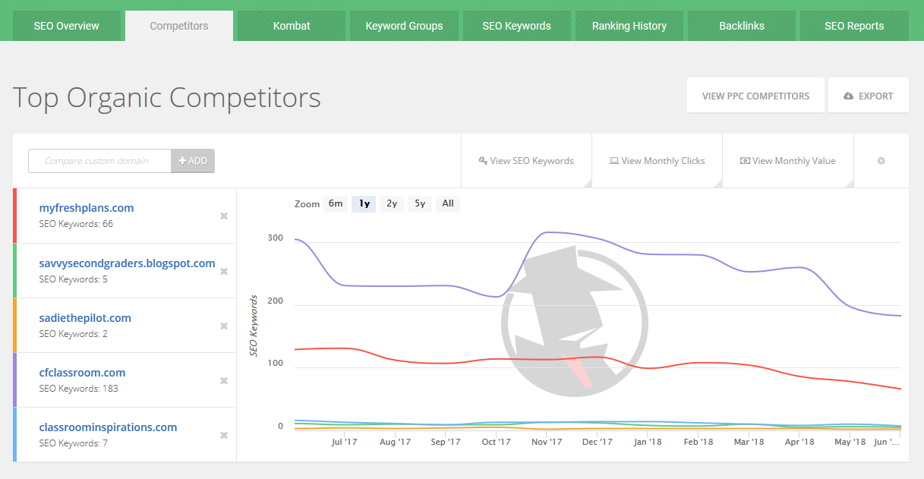
Keywords you can compete for
www.spyfu.com

Slide 11


Rely on long-tail keywords
www.hadeninteractive.com/long-tail-keywords-explained/

Slide 12
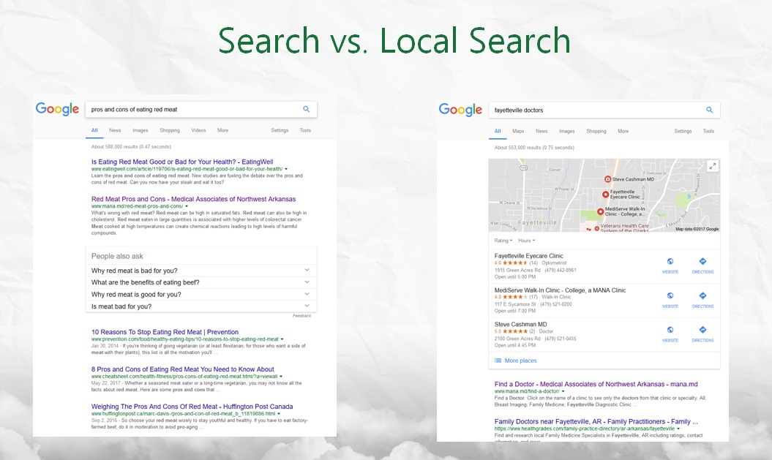
Remember local search is different

Slide 13
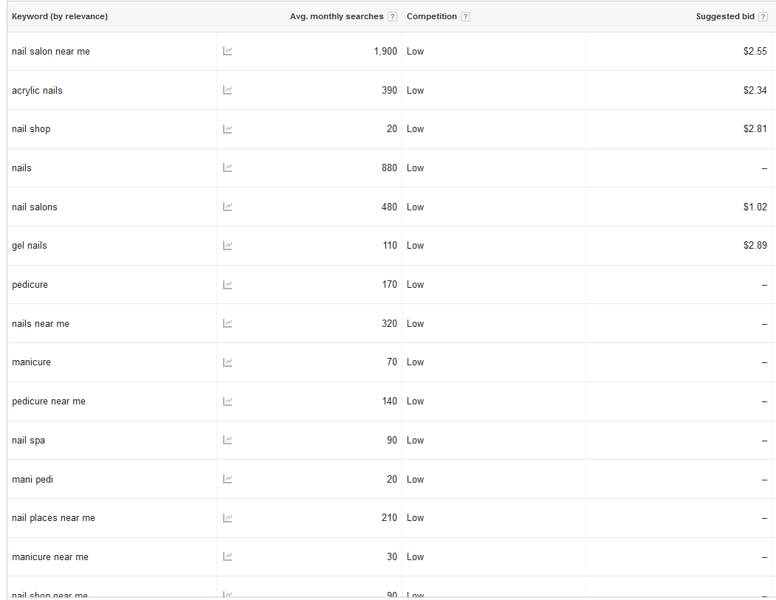
Local search keywords
adwords.google.com/aw/keywordplanner/home

Slide 14

Our Experiment

Slide 15
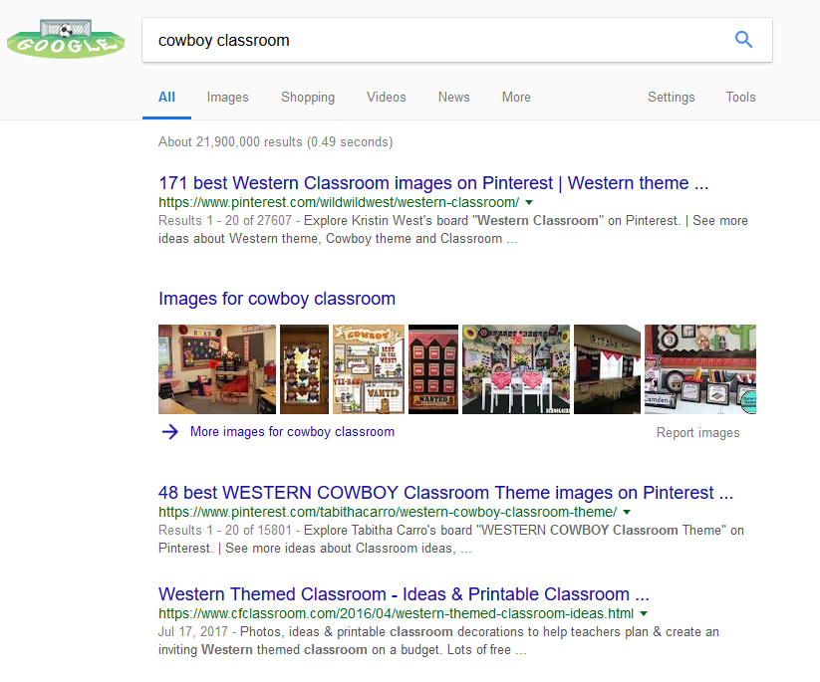
Our keyword: “cowboy classroom”

Slide 16
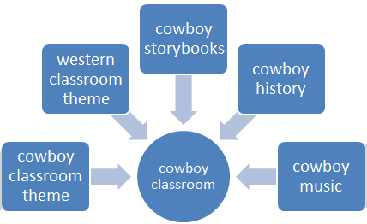
Step 2: Identify related keywords
Identify related keywords for the spokes.
Use Google Keyword Planner
Use WP Keyword Suggestion Tool

Slide 17
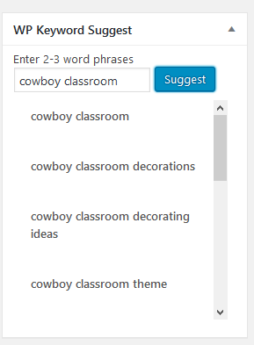
Related keywords
www.hadeninteractive.com/using-keyword-tools/

Slide 18
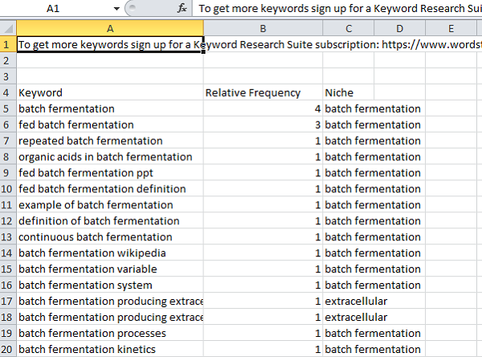
How closely related?

Slide 19
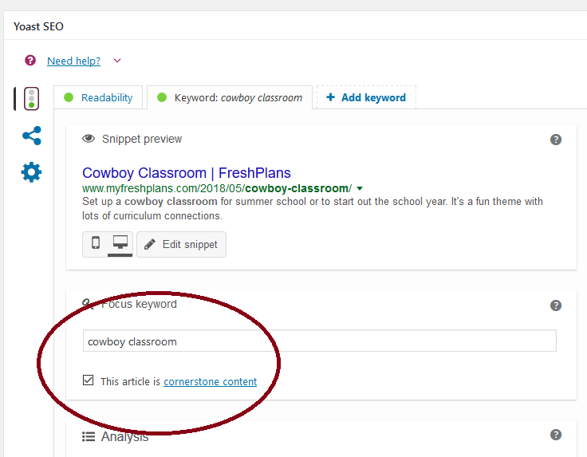
Step 3: Create hub content
Create or optimize the hub content.
Use Yoast SEO plugin

Slide 20

Your goal: the best page on the internet for your keyword
www.hadeninteractive.com/good-content-defined/

Slide 21
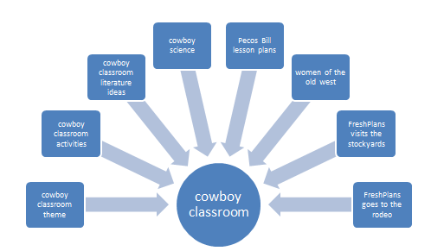
Step 4: Map your content
Find the related keywords for which you already have content.

Slide 22
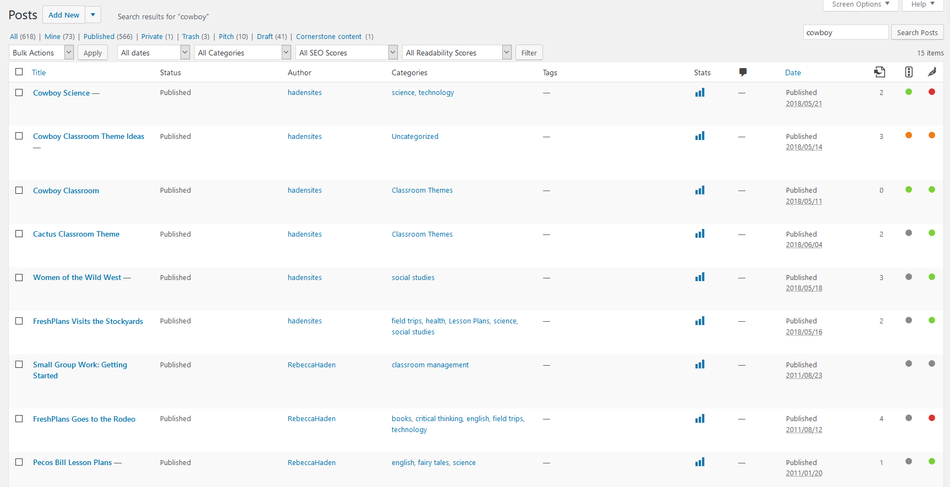
Step 5: Optimize/create spoke content
Yoast

Slide 23
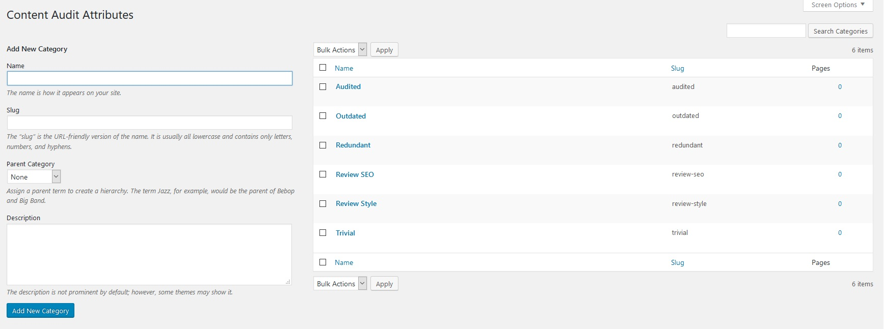
Content Audit plugin

Slide 24
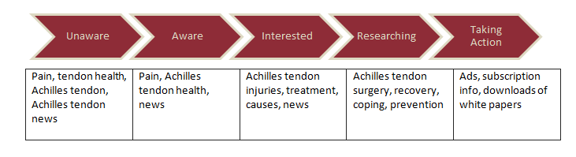
How to choose topics for new spokes
Create a granular strategy
Answer every question you can possibly imagine.
It’s a continuum.

Slide 25
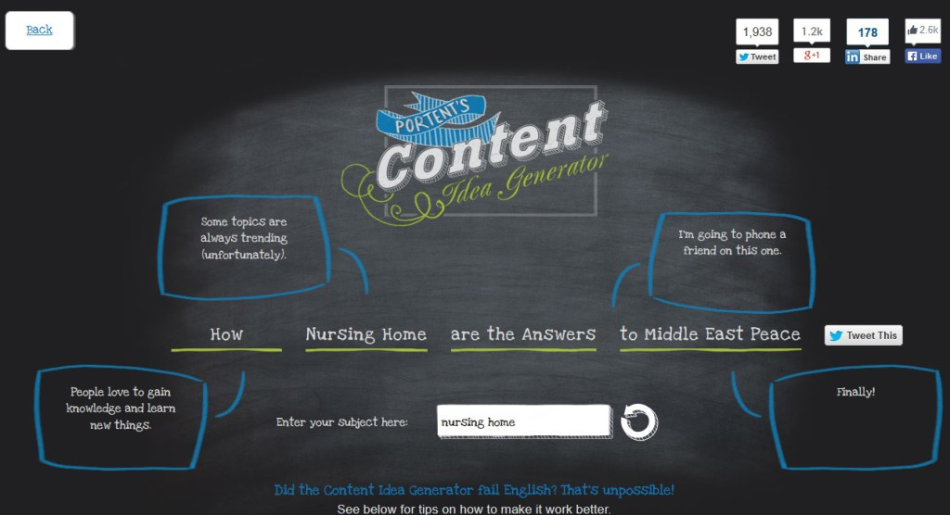
Blog title generators
https://www.hadeninteractive.com/blog-idea-generators-tools-toys/

Slide 26
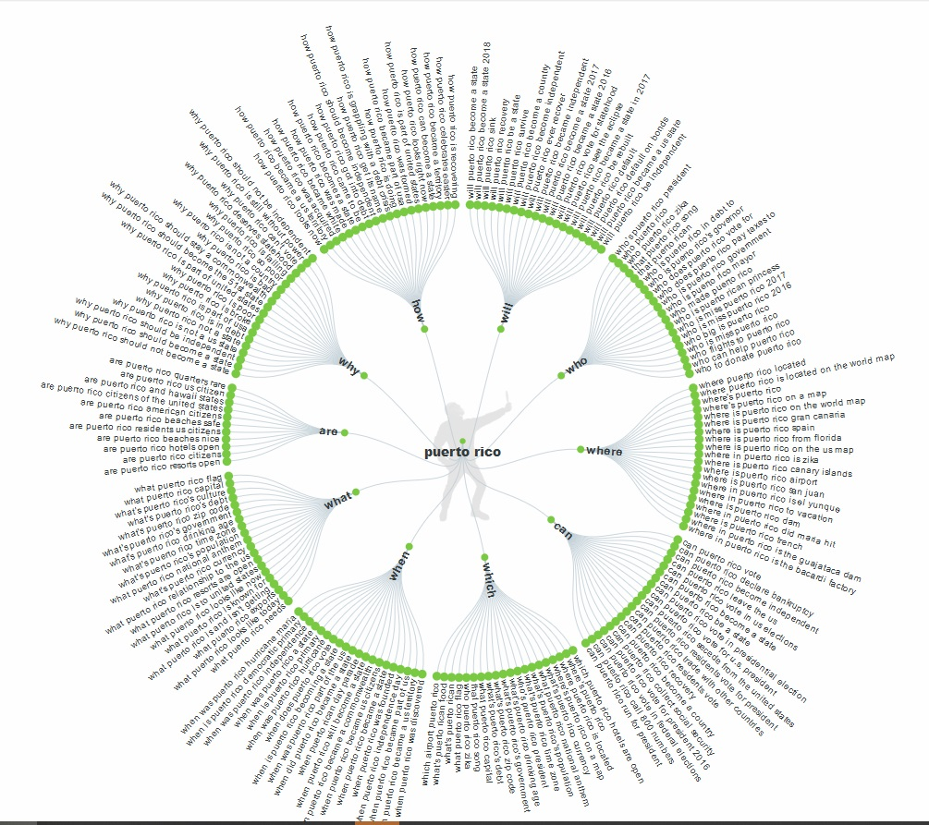
Answer the Public

Slide 27
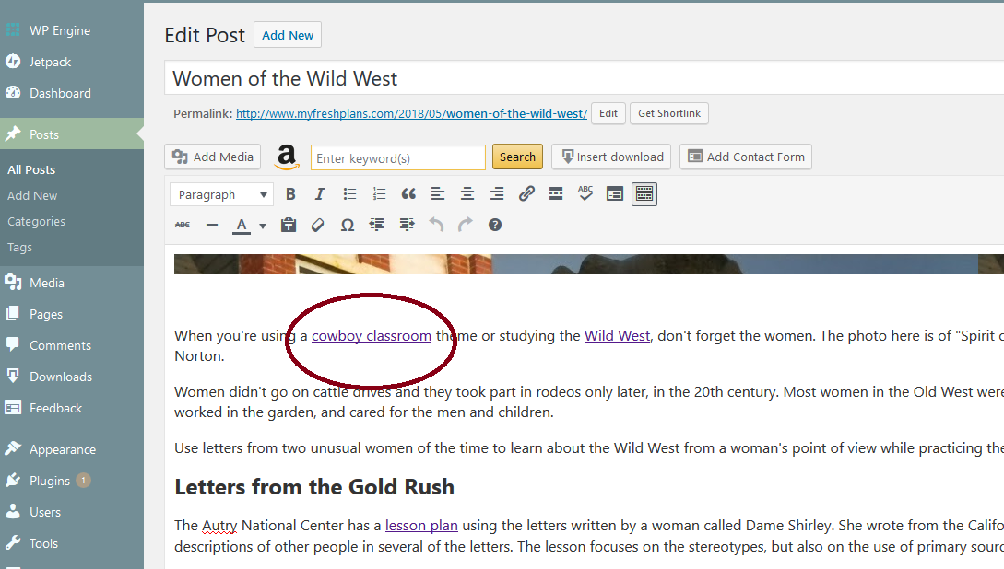
Step 6: Link spokes to the hub

Slide 28
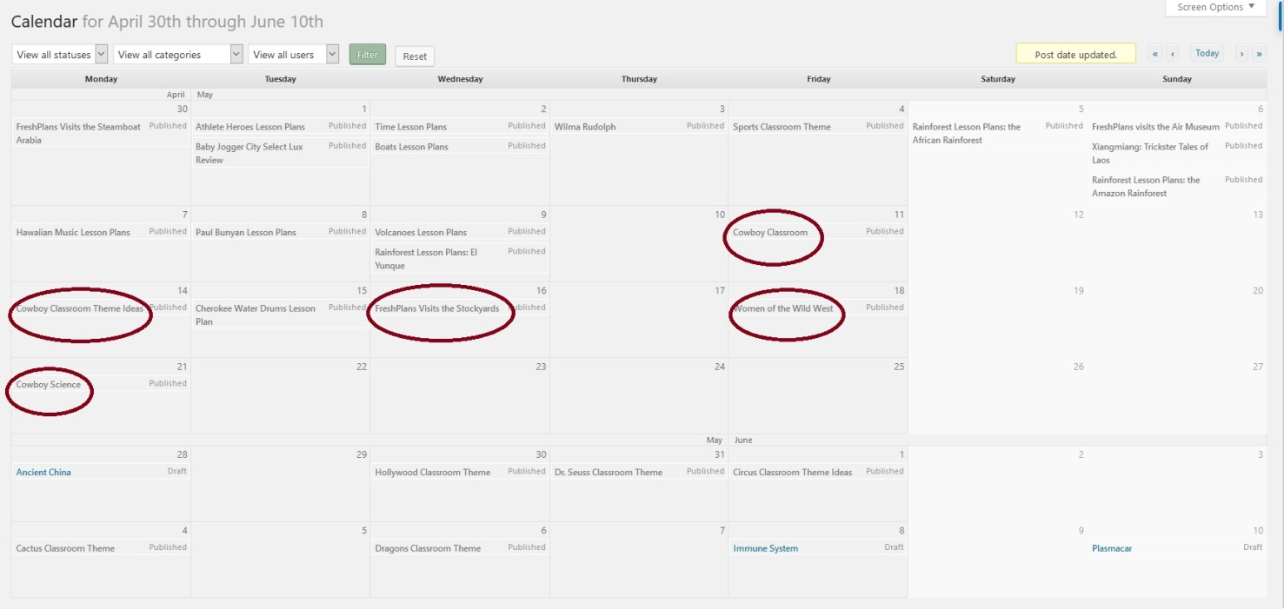
Step 7: Schedule new spoke content
Edit Flow

Slide 29
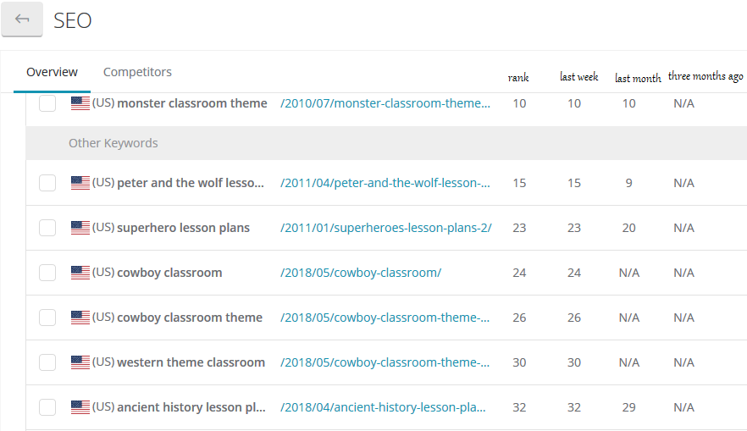
Step 8: Find your baseline
ManageWP

Slide 30
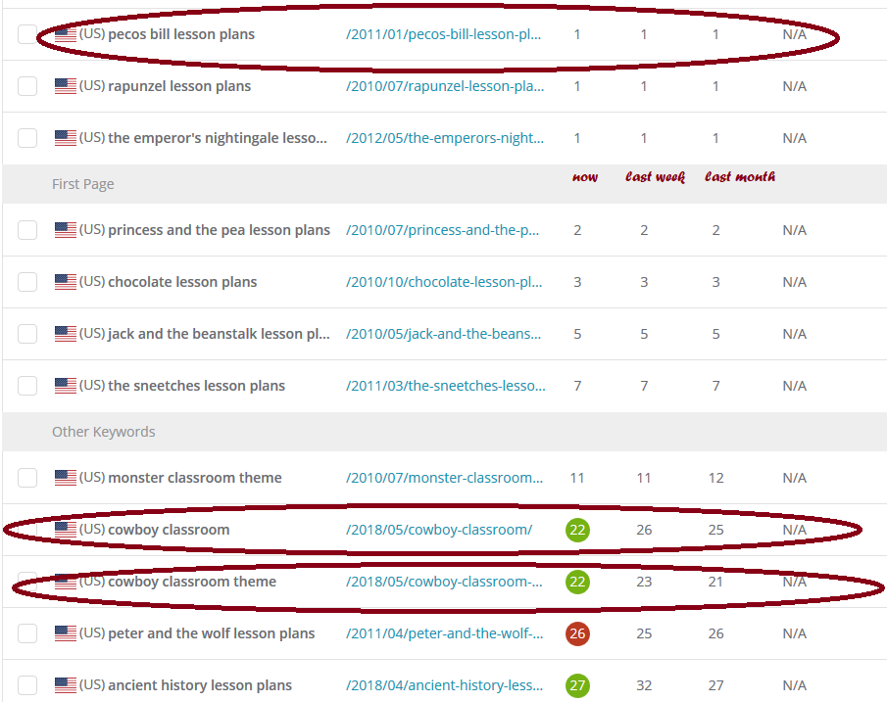
Step 9: Monitor content rankings
www.Managewp.com

Slide 31
Step 10: Keep working on it
Improve your posts/pages.
Add to your posts/pages.
Add more spokes.
Share in social media.
Ask for links from relevant, high quality websites.
Be persistent.
As you rank with one content cluster, add another… and another…

Slide 32






Get in Touch
www.HadenInteractive.com
(479) 966-9761
1337 E. Ash
Fayetteville, AR, 72703
Rebecca@HadenInteractive.com
Haden Interactive
@RebeccaHaden
@HadenInteractiv
29

Slide 33

Thank you for your attention !
www.Hadeninteractive.com

